Slide 1
Project Progress Review #3
(Interim Exploration Progress)
Project Title : Linguistic Analysis of Indo-European Languages
Project ID : PW19SMP003
Project Guide : Prof. Shreekanth M Prabhu
Project Team : Roshan U[01FB15ECS246],
Sanath Bhimsen[01FB15ECS260],
Mukesh M Karanth[01FB15ECS361].

Slide 2
Project Abstract and Scope
This project is a research oriented project which deals with linguistic analysis of Indo-European Languages using Social Network analysis.
We use data set that contains words from multiple languages to perform similarity measures and centrality measures between the words of different languages to find hidden links between languages.
The scope of the project is subject to the project being a minor project with time constraints, hence we are making use of transliterated words, the number of words is limited to a max of 200 and we are using a select number of centrality and similarity measures.

Slide 3
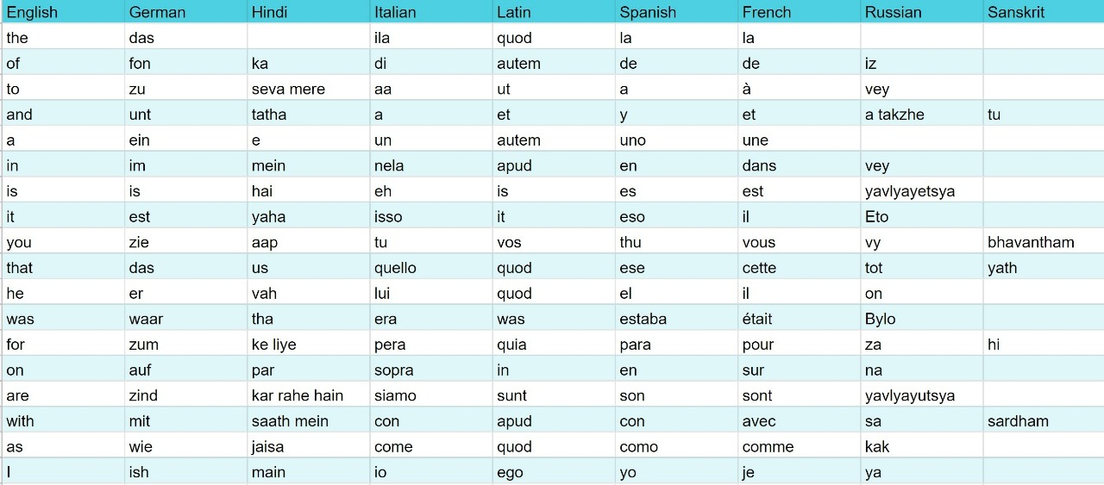
Data Set

Slide 4
Research Design Approach
Design approach: Top-Down Approach
Benefits:
Decreased Risk: Since the approach is planned well in advance.
Good Organization: Tasks are determined and filtered down without any confusion because project goals are set and will not be affected by outside opinions.
Minimized Cost: Members are free to complete their own tasks unique to their role in the project and aren’t saddled with the responsibility of setting project-wide goals.

Slide 5
Drawbacks:
Limited Creativity: Members are engrossed in their responsibilities and are unable to contribute innovations/ideas to the project — sometimes leading to frustration and a lack of motivation to perform.
Slow Response to Challenges: When a challenge arises as a result of a decision, it can take time for the members to establish a solution because there are limited minds contributing to decisions.

Slide 6
Design Constraints, Assumptions & Dependencies
DEPENDENCIES:
-> The usage is strictly limited only to study the effects and results of social network analysis on Linguistics and its representations.
-> The project requires packages which are good for visualization purposes and have good functionality for Network Analysis.
ASSUMPTIONS & CONSTRAINTS:
->A single language was taken from each of the lineages of the Indo-European Language, Proto-Indo-European.
->The number of words chosen to represent each language were all transliterated in English.
-> The maximum number of words in a single language is restricted to 200.

Slide 7
Interim Exploration
Basic Approach:
We formulated the project idea and established the end-user requirements
Then, we designed the project’s features and functionality for the user requirements .
Next, we decided upon the technologies that would be necessary to envision our project.
Finally, we divided the work amongst the members and started working on our parts to get the project work done.
Is there a need for changing the approach?
No, The development of the project is going forward smoothly as all the members are aware of their responsibilities and the tasks are completed on time.

Slide 8
Technologies Used
TECHNOLOGIES:
-> Applications:
-Google Translate API: Used to retrieve transliterated words quickly and in bulk.
-Jupyter Notebook: For its GUI and ease of use.
-Rstudio: consolidated representation of results, command prompt and single shot execution of programs.
-> Languages:
- Python: Used because of its ease of programing and amazing libraries that provide wide range of functionality in analytics.
- R : Used for visualisation because of its packages that aid good visualisation and its simplicity.

Slide 9
Project Progress So far
Percentage completion of Project: ~60%
Progress from last time:-
Added Russian Language instead of Persian.
Included some of the suggestions from the panel, which include replacing few transliterated words with their actual pronunciation in the case of German, Spanish and Italian.
Performed similarity measures and computed similarities between various languages and within same languages.

Slide 10
Project Demo
Project Demo:
DataSet Creation
Python Similarity Calculations
R Visualisation

Slide 11
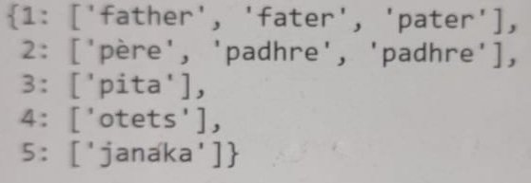
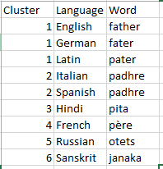
Output

Slide 12
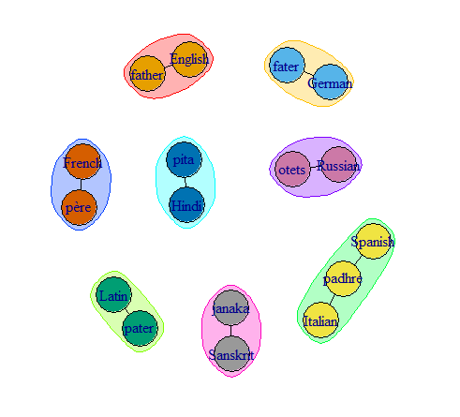

Slide 13
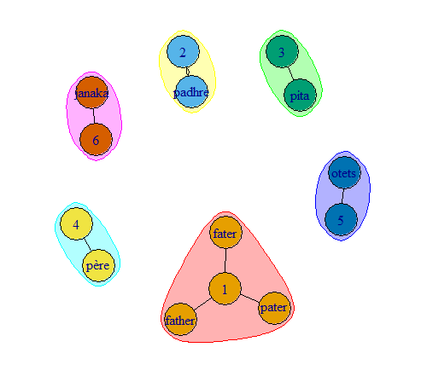
Clusters for the word “Father”

Slide 14
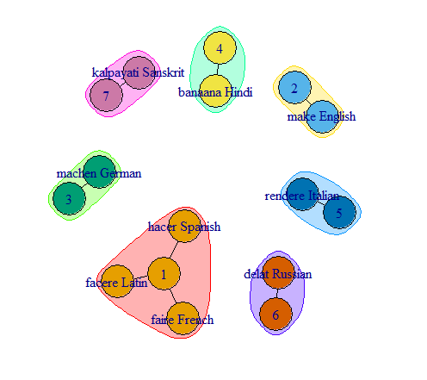
Clusters for the word “Make”

Slide 15
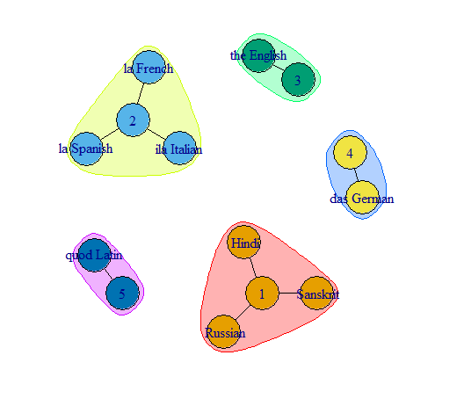
Clusters for the word “The”

Slide 16
Thank You

